Slide 1


Catch as catch can: Markets, availability, and fishery closures drive distinct responses among the U.S. West Coast Coastal Pelagic Species fleet segments
Old title: Substitution between coastal pelagic species under shifting target species distributions and policy constraints
Felipe J. Quezada^{1,2}, Desiree Tommasi^{1,2}, Stephen Stohs²,
Tim Frawley^{1,2}, Isaac Kaplan³ and Barbara Muhling^{1,2}
¹ University of California Santa Cruz
² NOAA Southwest Fisheries Science Center
³ NOAA Northwest Fisheries Science Center
ECCWO-5 – Session 16
Lisbon, Portugal – April 21st, 2023
Notes:
“Part of the CAFA project that looks impact of climate change on forage species (e.g. coastal pelagic species)”

Slide 2
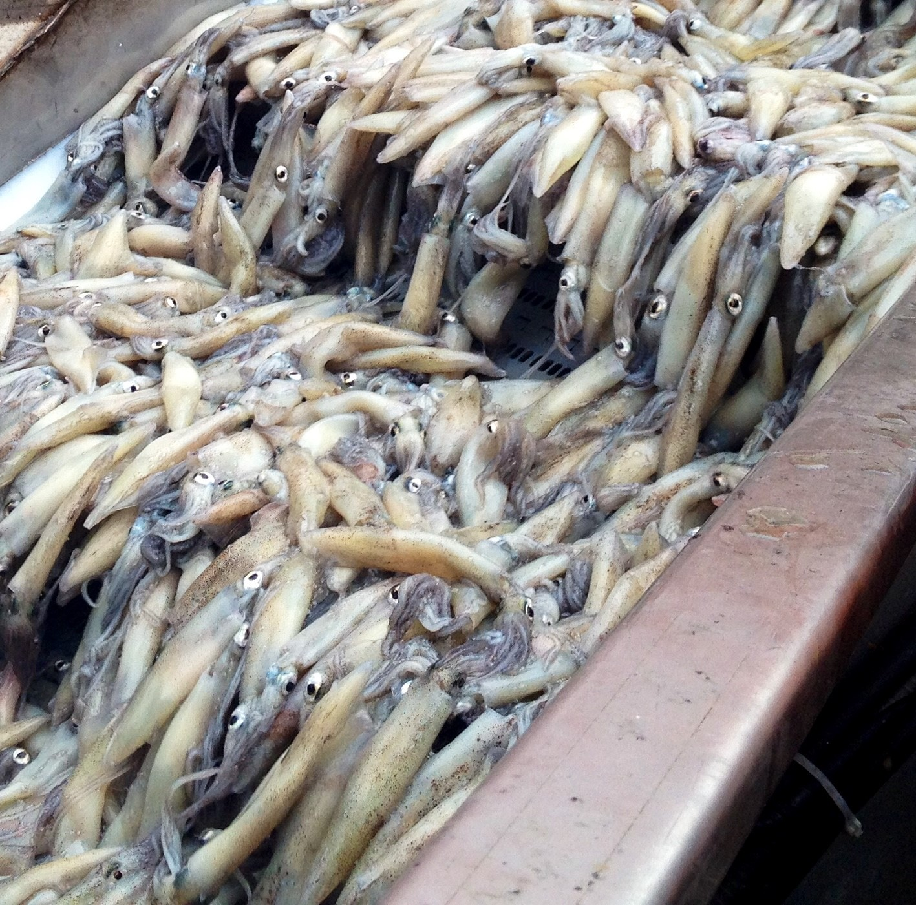
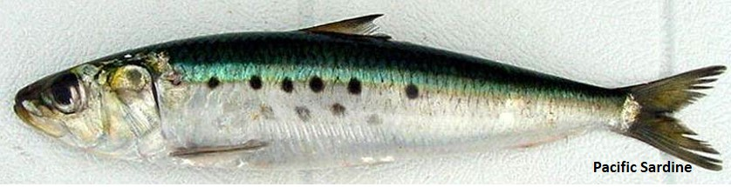
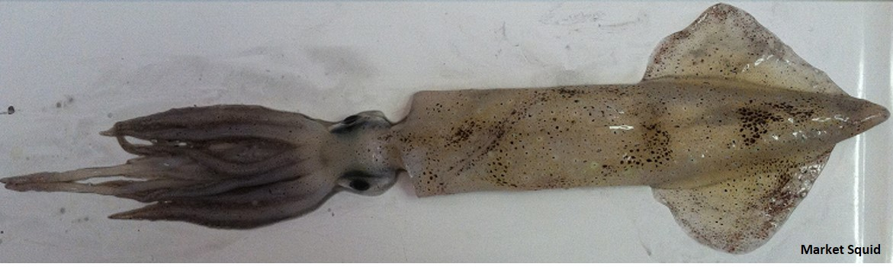
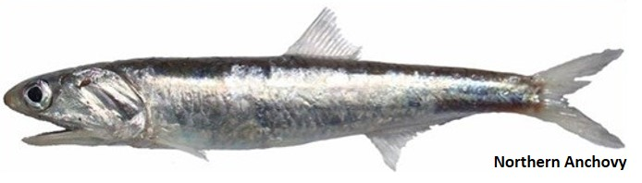
Introduction
Species availability will be affected by climate change
Changes on fishing ground and fish availability.
How will changes in species distribution and regulations affect landings in the U.S. Coastal Pelagic Species (CPS) fishery?
Landings models for squid, anchovy and sardine
All forage species for the U.S. West Coast
Interrelated through species availability and regulations
Daily vessel-level landings data by port over the period from 2000 to 2020.
Include revenue, price at port, vessel length, species caught, trip ID.

Slide 3
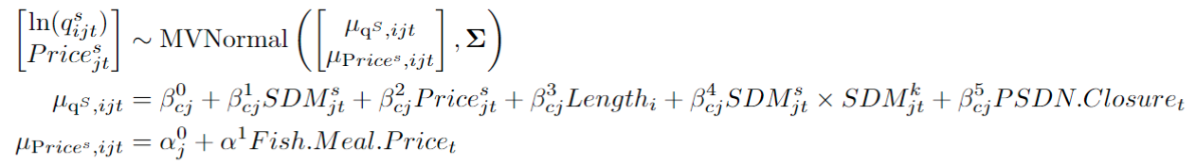
Methodology
Monthly averages by port area and vessel.
Empirical model:
Log of landings as outcome variable (left hand side)
Explanatory variables:
Own SDM output
Other species SDM x Own SDM
Species price
Vessel length
All coefficients varies by cluster/ports → allow for fleet heterogeneous response to inputs.
c: cluster
j: port-area
t: month
i: vessel

Slide 4
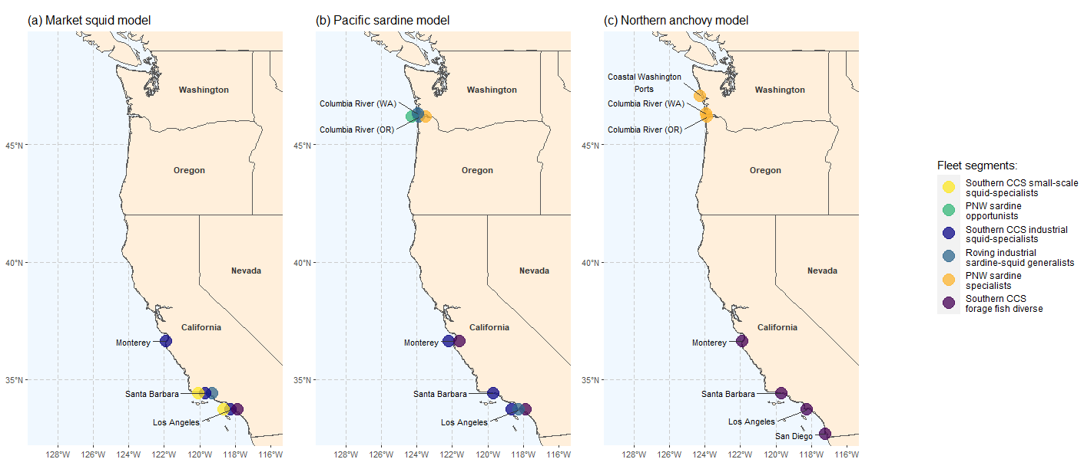
Methodology

Slide 5
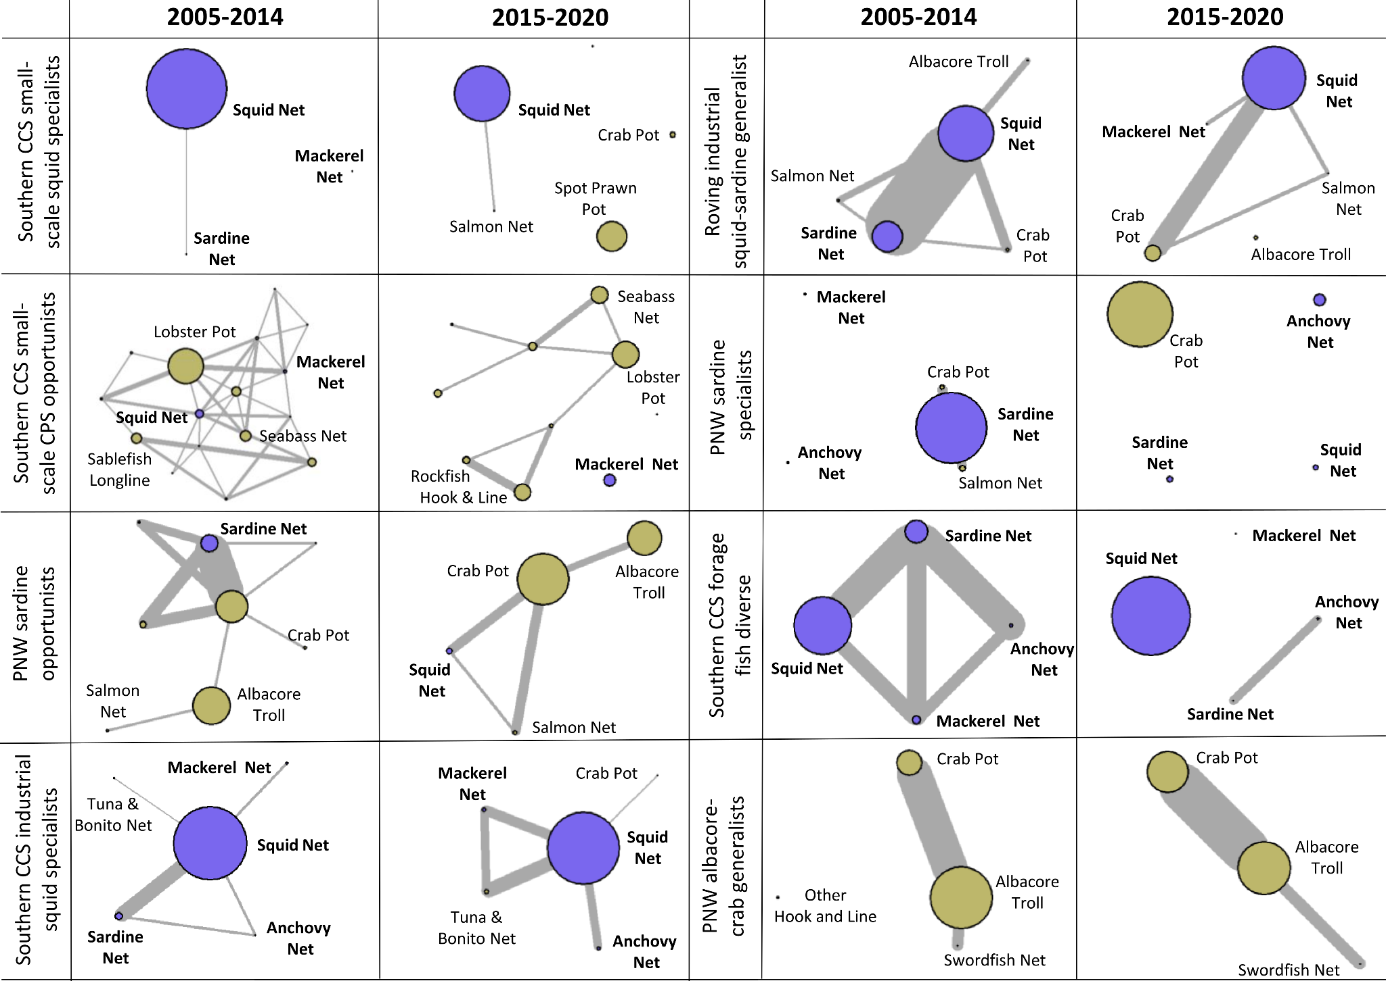
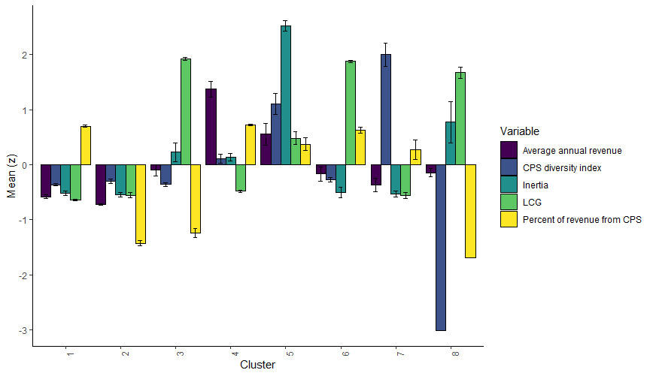
Fleet segments

Slide 6
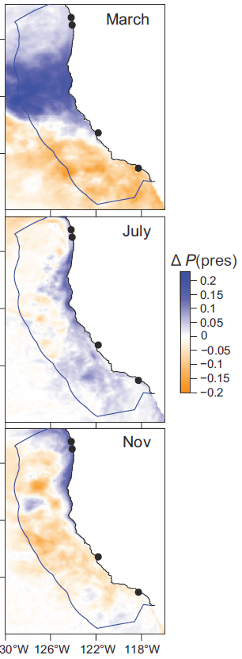
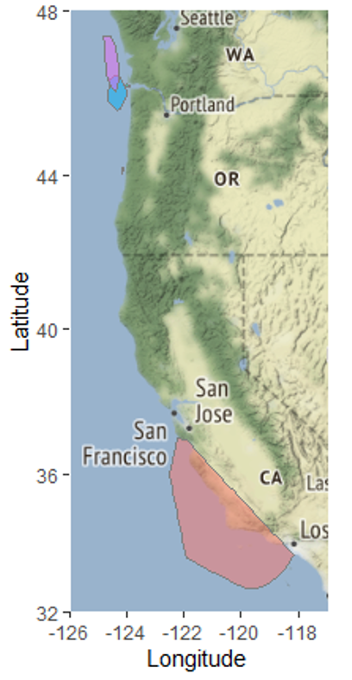
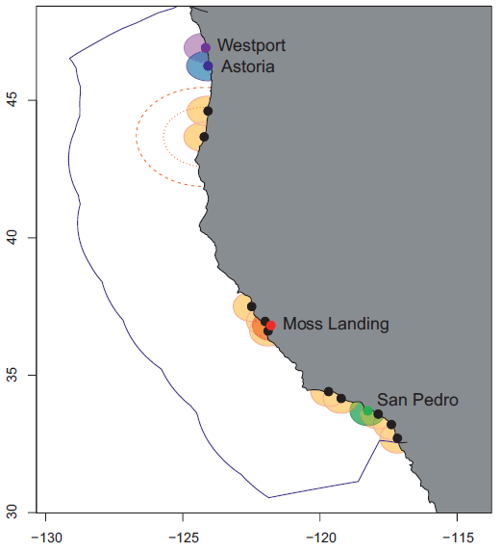
Landings model: SDMs link to Landings
Figure from
Smith et al. 2020
Figure from Smith et al. 2020
Inputs:
Chlorophyll
SST
SSB
Fig. Convex hull fishing grounds
Fig. Port radius
Fig. Species Distribution Model outputs.
Daily probability of presence by lat/long (0.1 degree of resolution) from 1998 to 2019

Slide 7
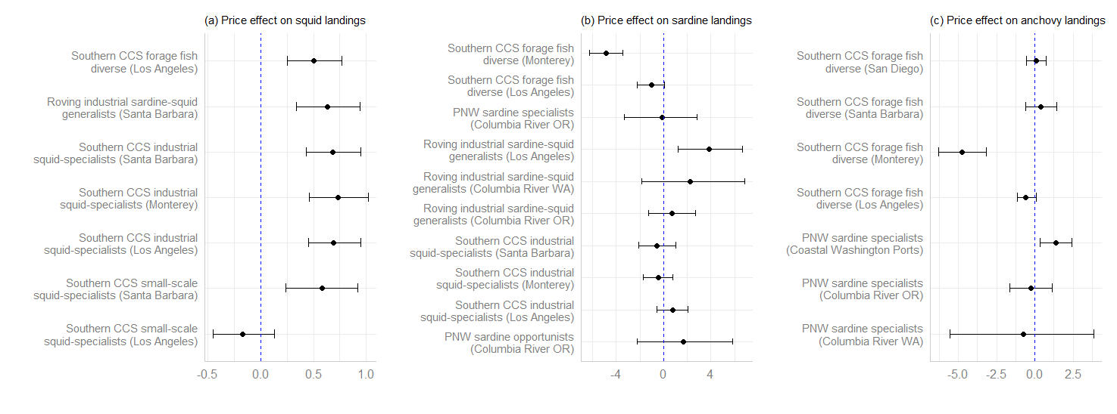
Results – Price effects
(Preliminary results submitted for publication)
A larger number of fleet segments/port areas for squid landings are price-sensitive than for sardine and anchovy.
Forage fish diverse is affected negatively by prices at Monterey
Maybe omitted variable bias? Correlation with more valuable species in Monterey, shifting to those species when there is a general increase in prices.

Slide 8
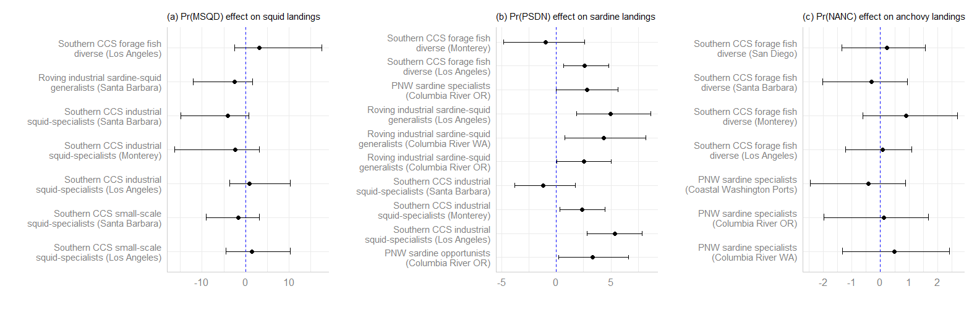
Results –Own SDM effects
(Preliminary results submitted for publication)
No significant effects of own SDM on squid and anchovy landings.
Significant effects of own SDM on sardine landings for almost all fleet segments/port areas.

Slide 9
Results – The effect of the Pacific sardine closure
(Preliminary results submitted for publication)

Slide 10
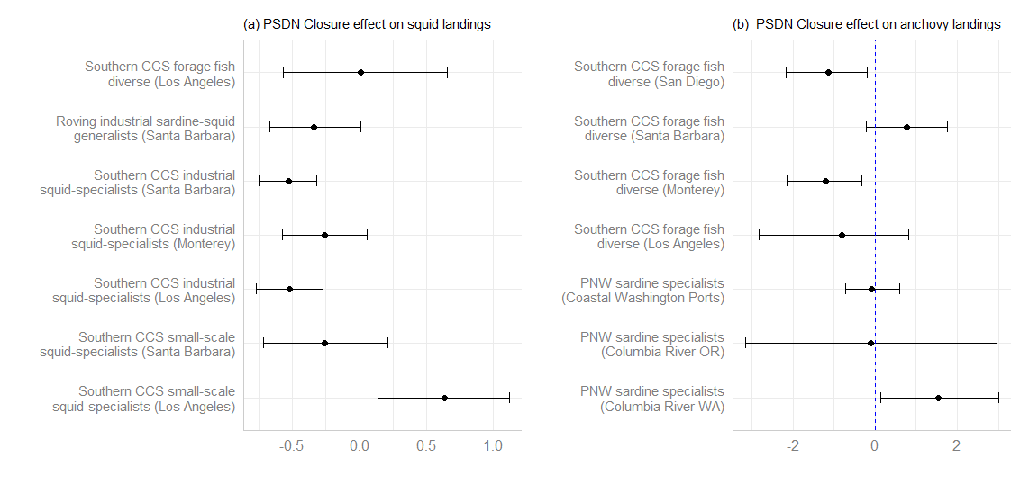
Results – The effect of the Pacific sardine closure
(Preliminary results submitted for publication)
Negative and significant effect on
Squid landings for the “Southern CSS industrial squid-specialists” fleet segment at Santa Barbara and LA
Anchovy landings for the “Southern CCS forage fish diverse” fleet segment at San Diego and Monterey.
Significant and positive effect of the closure on
Squid landings for the “Southern CCS small-scale squid specialist” fleet segment at Los Angeles,
Anchovy landings for the “PNW sardine specialists” fleet segment at Columbia River in Washington.

Slide 11
Conclusions
Vessel heterogeneity and landing port are important in explaining vessel responses to species availability and other drivers.
Effects differ by species, suggesting that the decision process influencing CPS targeting reflects factors that vary over economic markets and ecological characteristics.
However, some major generalizations are evident:
Importance of sardine availability in determining sardine landings per vessel.
Squid landings per vessel are driven mainly by market conditions and do not respond to changes in squid’s SDM
Omitted variable bias? Squid SDM being an imperfect index of availability?
In contrast, landings per vessel of anchovy not correlated with SDM or market conditions
Driven instead by conditions observed for Pacific sardine (not presented…)

Slide 12
Conclusions
The strong relationship found for sardine between availability and per-vessel landings cannot be generalized to squid and anchovy.
Other factors, such as the availability of other target species, regulations and market conditions, need to be considered to understand ex-vessel landings.
Our analysis of the response of different fleet segments in the CPS fleet to the 2015 sardine fishery closure provides insights on the impact of a dramatic shift in availability on different fleet segments and their potential vulnerability to future changes in fishing opportunities.

Slide 13
Conclusions
No universal truth can be applied across fisheries.
Some generalizations as well as some heterogeneous drivers of landings for most high-volume CPS fleet segments and ports.
However, for certain fleet segments and ports, particularly for mid- and low-volume CPS fleets, motivations and drivers of landings are less clear.

Slide 14
Thanks for your attention!
Contact information:
fequezad@ucsc.edu
felipequezada.com

